Slide 1

Welcome To Our
Online Marketing Training
Company
Logo
Company Name
Presenter: John Doe

Slide 2
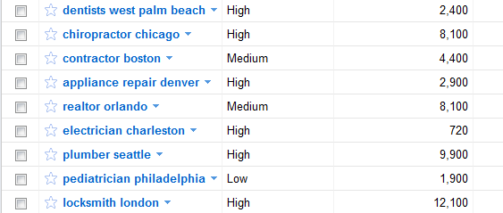
Everyday People Look Online For Your Services
Samples Of The Customer NICHE and KEYWORDS if POSSIBLE
Your Company Name / Branding

Slide 3
Question?
Would You Buy A Product
Or Service That Has
Bad Ratings And Reviews?
Your Company Name / Branding

Slide 4
Question?
Two Products Are Identical
One Has 10 Good Reviews
One Has 3 Review & 1 Bad Review
Which One Would You Buy?
Your Company Name / Branding

Slide 5
Welcome To Our
Most Important Way
You Can Market Your Business
Your Company Name / Branding

Slide 6
Your Reputation Is EVERYTHING
The Online Marketing
Game Has Just Changed
And Your Competition
Doesn’t Know About It… Yet
Your Company Name / Branding

Slide 7
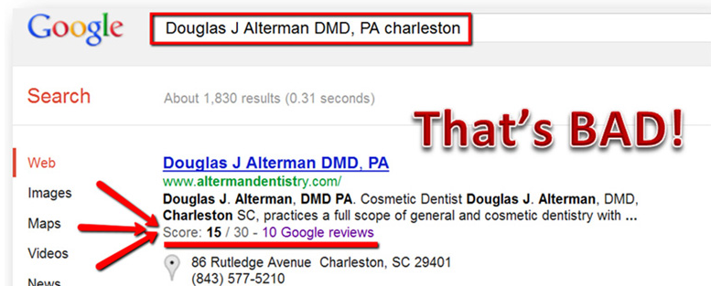
Game Changer #1
Any Company Name + City
Reveals The Company’s Reputation

Slide 8
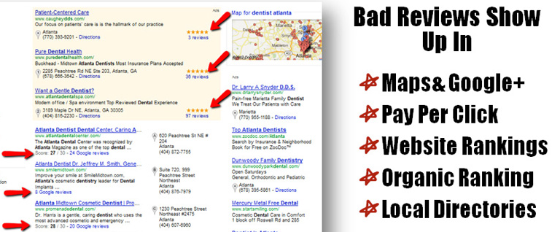
Game Changer #2
Customer Reviews Are A Major Factor
In Almost Every Type Of Online Marketing

Slide 9
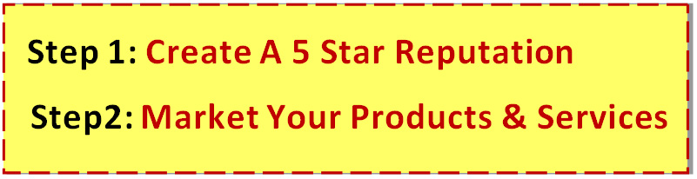

Game Changer #3
SEO… Social Media… Pay Per Click… Local Marketing
NONE OF IT WORKS ANYMORE!
If You Have Bad Reviews Online

Slide 10
Game Changer #4
Reviews Send You Prequalified Presold Customers. Because Buyers Trust Reviews…
As Much As Personal Recommendations.
72% Of Buyers Trust Reviews As Much As Personal Recommendations

Slide 11
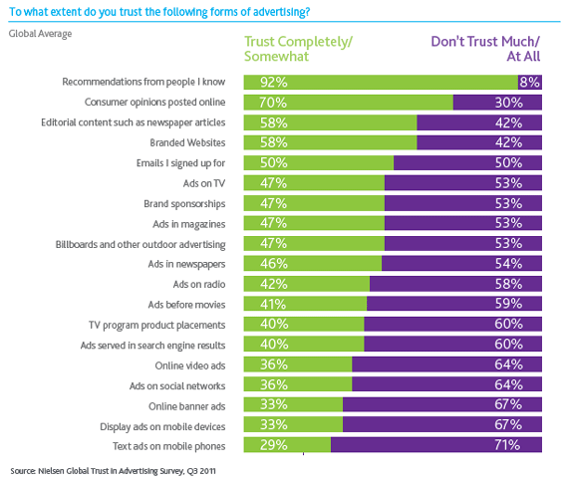
Game Changer #4

Slide 12
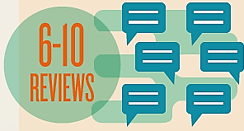

Why Reputation Is Vital To A Business
Consumers Look Up An Average Of
10 Reviews Before Making A Decision
“70% Of Consumers Trust A Business With A
Minimum Of 6 – 10 Reviews”
Without Ten 5 Star Reviews
Your Business Isn’t Trusted

Slide 13

What Is Reputation Marketing?
Positioning Yourself As
The Market Leader In Front Of
Thousands Of Buyers With A
5 Star Reputation

Slide 14
How Do You Create A
STRATEGY

Slide 15
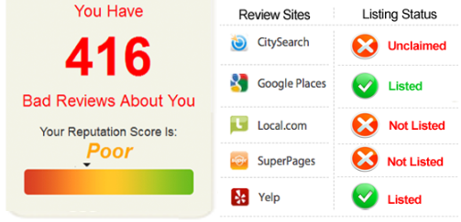

STRATEGY
Do You Know Your Reputation Online?

Slide 16
STRATEGY
4 Types Of Reputations
Bad Reputation
No Reputation
Good Reputation
5 Star Reputation

Slide 17
STRATEGY
1) Develop 5 Star Reputation
2) Market That Reputation
3) Manage That Reputation
4) Create A Reputation Marketing Culture

Slide 18
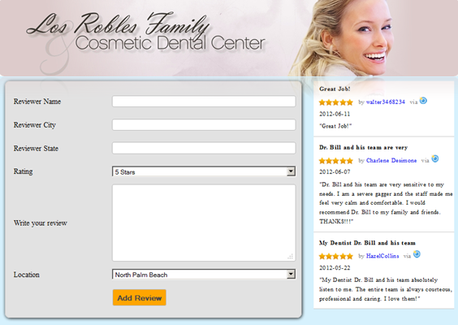

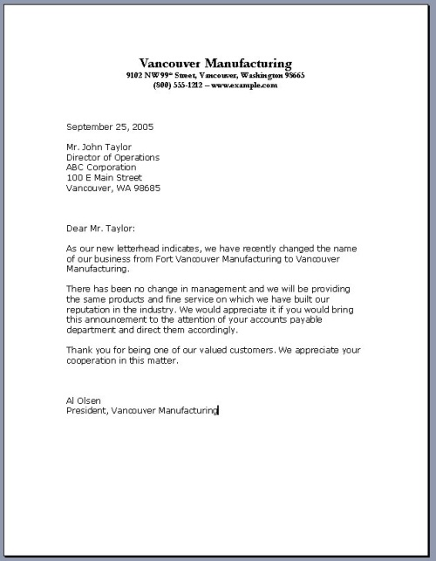





STRATEGY
Develop Your 5 Star Reputation
Postcards
Business Cards
Email Templates
Plus Many More..
Private Review Page
Posting Strategy

Slide 19

STRATEGY
Develop Your 5 Star Reputation
Businesses Can’t Post Reviews From Customers
Review sites have algorithms and filters that delete all reviews that are posted from the same computer IP network.
We have proprietary systems and processes that can post reviews for a company without being filtered or deleted.

Slide 20
STRATEGY
Market Your 5 Star Reputation
Video Review Marketing
Website Marketing
Social Media Marketing
Email Marketing
Maps Marketing
Sales Marketing

Slide 21
STRATEGY
Manage Your 5 Star Reputation
Daily Monitoring – Google Alerts Doesn’t Work
Bi-Weekly Reporting
Daily Review Alerts – Negative And Positive
Location Based Reporting – Each Location Is Unique
Continuing To Grow Your Reviews
Posting Reviews – Can’t be Done By An Individual
Manage By Marketing Only The 5 Star Reviews

Slide 22
STRATEGY
Create A Reputation Marketing Culture
You Expect Your Staff To Give 1st Class Service Right?
So What’s Your Plan To Inspire Your Staff To Give
1st Class Service To You Customers & Get Raving Reviews?
Plan:
Personalized Reputation Training Center

Slide 23
Your Reputation Is EVERYTHING
Reputation Marketing Is The
Most Important Marketing
Every Company Needs A Strategy
We Can Put One Together For You

